Slide 1
Secure Programming 程式安全
Chap4: Static Analysis Internals
Building a Model
Analysis Algorithms
Rules
Reporting Result
Summary

Slide 2
Static Analysis Internal
Internal
  Data Structures (to represent the model)
  Analysis Techniques
  Rules
  Results Reporting
Generic Static Analysis Tool
  Accept Code
  Build a Model (representing the program)
  Analyze the Model with a body of security knowledge
  Present Results

Slide 3
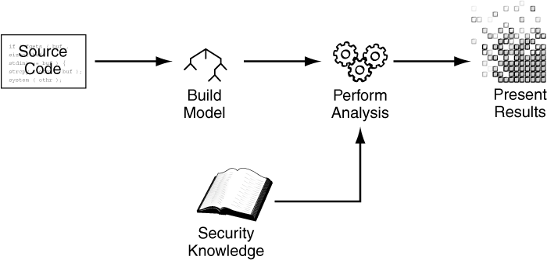
A generic static analysis security tool

Slide 4
Building a Model
Transform the Code to be Analyzed into a Program Model:
A set of Data Structures:
Representing the Code

Slide 5
Building a Model
Lexical Analysis
Paring
Abstract Syntax
Semantic Analysis
Tracking Control Flow
Tracking Dataflow
Taint Propagation
Pointer Aliasing

Slide 6
Lexical Analysis
if (ret) // probably true
mat[x][y] = END_VAL;
IF LPAREN ID(ret) RPAREN ID(mat) LBRACKET ID(x) RBRACKET LBRACKET
ID(y) RBRACKET EQUAL ID(END_VAL) SEMI

Slide 7
Sample lexical analysis Rules
if { return IF; } ( { return LPAREN; } ) { return RPAREN; } [ { return LBRACKET; } ] { return LBRACKET; } = { return EQUAL; } ; { return SEMI; } /[ \t\n]+/ { /* ignore whitespace */ } /\/\/.*/ { /* ignore comments */ } /[a-zA-Z][a-zA-Z0-9]*"/ { return ID; }

Slide 8
Parsing
Use a context-free grammar (CFG) to match the token system
Perform a derivation by matching the token stream against the production rules
If each symbol is connected to the symbol, a parse tree formed

Slide 9
Production Rules for Parsing the Sample Token Stream
stmt := if_stmt | assign_stmt if_stmt := IF LPAREN expr RPAREN stmt expr := lval assign_stmt := lval EQUAL expr SEMI lval = ID | arr_access arr_access := ID arr_index+ arr_idx := LBRACKET expr RBRACKET

Slide 10
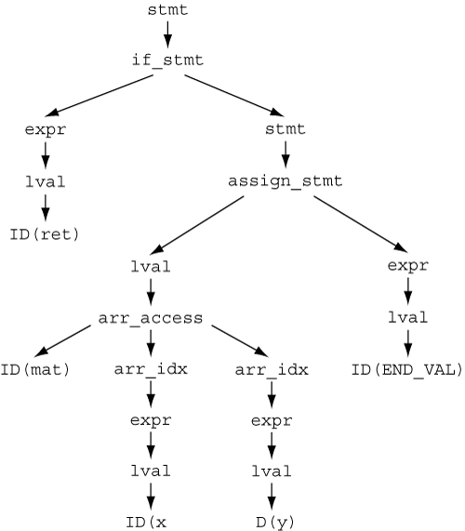
A parse tree derived from the sequence of tokens

Slide 11
Abstract Syntax
Derivation Tree
  Derived from Production rules with nonterminal symbols for making parsing easy
Abstract Syntax Tree (AST)
  A standardized version of the program suitable for later analysis
  Abstract away the details of the grammar and the syntactic sugar in the program text
  Lowering
    Method calls converted to function calls
    For and do loops converted to while loops
    C and C++ can be lowered into the same AST format
    C++ and Java might share many of the same AST node types

Slide 12
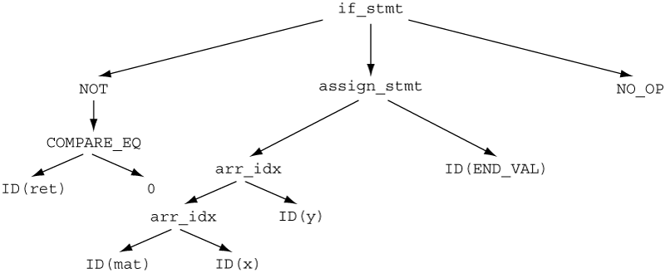
An abstract syntax tree

Slide 13
Semantic Analysis
AST with symbol table
  Perform type checking
  Convert implicit type conversions to explicit type conversions
Semantic Analysis
  Symbol Resolution
  Type Checking
Compiler
  Generate an intermediate representation for optimization or platform-specific object code
Static Analysis Tool
  Own variety of intermediate representation for further analysis

Slide 14
Tracking Control Flow
Intra-procedure Control Flow
  Nodes in the control graph: basic blocks
  Edges: control flow paths between basic blocks
  Back Edges: loop
  Trace: sequence of basic blocks for a path through the code
Inter-procedure Control Flow
  Nodes: Functions
  Edges: one function to invoke another

Slide 15

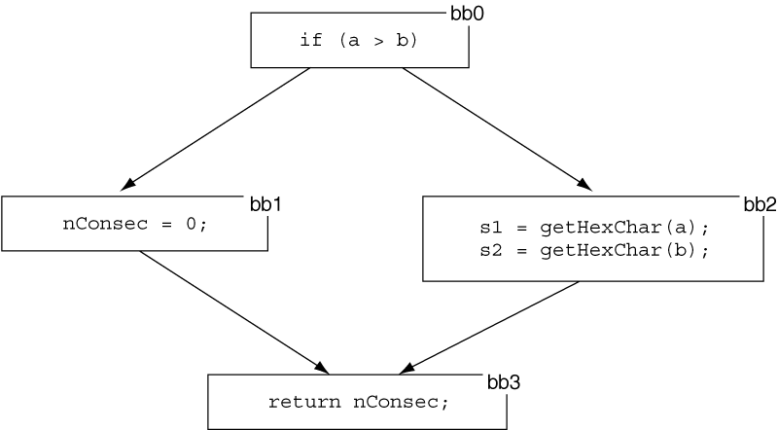
A control flow graph with four basic blocks
if (a > b) { nConsec = 0; } else { s1 = getHexChar(1); s2 = getHexChar(2); } return nConsec;
Two paths: [bb0, bb1, bb3] and [bb0, bb2, bb3]

Slide 16
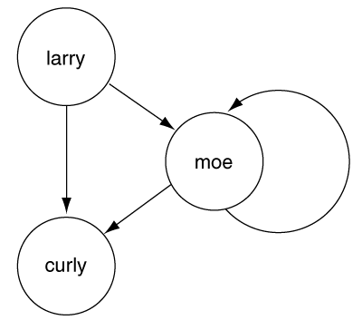
The call graph for the program
int larry(int fish) { if (fish) { moe(1); } else { curly(); } } int moe(int scissors) { if (scissors) { curly(); moe(0); } else { curly(); } } int curly() { /* empty */ }

Slide 17
Tracking Dataflow
Compiler tracking dataflow
  Register allocation
  Dead code removal
Static Single Assignment (SSA)
  Allow to assign a value to a variable only once
Applications
  An SSA variable assigned by a constant value, the constant can replace all uses of the SSA variable
  Constant propagation can be used for finding hard-coded passwords or encryption keys
Example: Tiny Encryption Algorithm (TEA)

Slide 18
TEA encryption with source and SSA
Regular source code form: sum = sum + delta ; sum = sum & top; y = y + (z<<4)+k[0] ^ z+sum ^ (z>>5)+k[1]; y = y & top; z = z + (y<<4)+k[2] ^ y+sum ^ (y>>5)+k[3]; z = z & top;
SSA form:
sum₂ = sum₁ + delta₁ ;
sum₃ = sum₂ & top₁;
y₂ = y₁ + (z1<<4)+k[0]₁ ^ z₁+sum₃ ^ (z₁>>5)+k[1]₁;
y₃ = y₂ & top₁;
z₂ = z₁ + (y3<<4)+k[2]₁ ^ y₃+sum₃ ^ (y₃>>5)+k[3]₁;
z₃ = z₂ & top₁;

Slide 19

SSA using a φ-function (merge from two control flow paths)
Regular source form: if (bytesRead < 8) { tail = (byte) bytesRead; }
SSA form:
if (bytesRead₁ < 8) {
tail₂ = (byte) bytesRead₁;
}
tail₃ = φ(tail₁, tail₂);

Slide 20
Taint Propagation
Using dataflow to determine what an attacker can control
Determine
  Where information enters the program
  How it moves through the program
Key issues
  Input Validation
  Representation Defects
Example
  Exploitable Buffer Overflow: dataflow path from input function to a vulnerable function
Analysis
  Static Analysis: dataflow
  Dynamic Analysis: Perl’s taint mode, user-supplied data validated with regular expression, before used as a sensitive operation

Slide 21
Pointer Aliasing
Understand which pointers could possibly refer to the same memory location
Pointer Relationship
  Must alias
  May alias
  Cannot alias

Slide 22
Pointer Aliasing Analysis
To reorder the following statements only if p1 and p2 are not aliased
*p1 = 1;
*p2 = 2;
Flow-sensitive taint-tracking needs to know data flow from gerUserInput() to processInput()
p1 = p2;
*p1 = getUserInput();
processInput(*p2)

Slide 23
A generic static analysis security tool

Slide 24
Analysis Algorithms
Checking Assertions
Naïve Local Analysis
Approaches to Local Analysis
Global Analysis
Research Tools

Slide 25
Analysis Algorithm
Context Sensitivity
Intraprocedural Analysis
  Individual Function
  Local Analysis
Interprocedural Analysis
  Interaction between functions
  Global Analysis

Slide 26
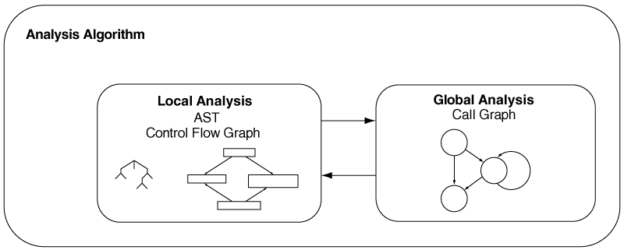
Analysis Algorithm with a local and global component

Slide 27
Checking Assertions
strcpy(dest, src);
adding this assertion to the program just before the call to strcpy(): assert(alloc_size(dest) > strlen(src));

Slide 28
Three Varieties of Assertions
Taint Propagation Problems
  SQL Injection and Cross-Site Scripting
  Trust Input when they should not
Range Analysis Problems
  Buffer Overflow
  Track the size of the buffer and the value used as an index
Type State Problems
  Memory Leak and Double Free
    Allocated state or freed state
    Memory in allocated state while no references: leak
    Memory in free state passed to free(): double free
  Temporal Safety Properties

Slide 29
Naïve Local Analysis
Symbolic Simulation
  Not Consider any concrete values for the variables
  Allow the variable to be represented as a symbol
  Evaluate the program for all possible value of a variable

Slide 30
Naïve Local Analysis
x = 1; | {} (no facts)
y = 1; | { x = 1 }
assert (x < y); | { x = 1, y = 1 }
x = v; | {} (no facts)
y = v; | { x = v }
assert (x < y); | { x = v, y = v }

Slide 31

Naïve Local Analysis with Conditional Predicate
x = v; | {} (no facts)
if (x < y) | { x = v }
y = v; | { x = v, x < y }
assert (x < y) | { x = v, x < y, y = v }
x = v;
if (x < y) {
y = v;
}
assert (x < y);
x = v; | {} (no facts)
if (x < y) | { x = v }
assert (x < y) | { x = v, ¬(x < y) }

Slide 33
Local Analysis
Abstract Interpretation
Predicate Transformers
Model Checking

Slide 34
Abstract Interpretation
Concrete Interpretation
  Too many details not relevant to the properties (of our interests)
Abstract Interpretation
  Abstract away aspects not relevant to the properties
  Perform Interpretation over the Abstraction
  Examples: Flow-insensitive analysis (order of statement not important)
    All execution order considered
    Eliminating Sophisticated control flow analysis
    False positives: some orderings of statement never occur

Slide 35
Predicate Transformers
Derive the requirements of a function for the callers
  Weakest Precondition (WP) introduced by Dijkstra (1976)
WP
  Fewest (weakest) set of requirements on the callers of a program
Transfomers
  Working backward from the last statement to the first
  Postcondtion transformed into the precondition
Example
  assert(x < y) for stronger requirement (x < 0 ∧ y >0)
  WP(assert(p), r) = p ∧ r
Abstract away the details of the program and create a summary of the requirements (imposed on the caller)

Slide 36
Model Checking
Model
  Program transformed to be checked as an automaton (called model)
Temporal Safety Property as Specifications
  Ex: Memory should be freed only once
  Ex: Only non-null pointers should be dereferenced
  Represented as a finite-state automaton
Checker
  Compare the specification to the model
  If the checker finds a variable and a path (through the program) to cause the automaton to reach the error state, a potential double free identified

Slide 37
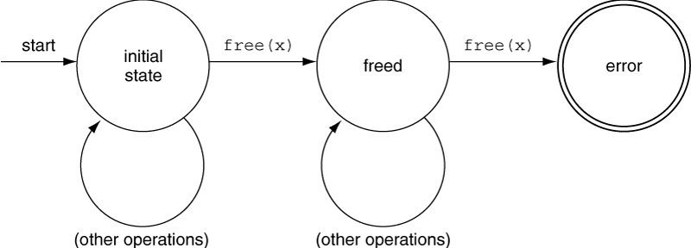
A finite-state automation for “freed only once”

Slide 38
Global Analysis
We can assume “intra-procedural” analysis
  But not work for input-validation and representation
  Across function boundaries
Approaches
  Whole-program analysis
  Inlining
  Function summaries

Slide 39
Vulnerabilities across function boundaries
static char progName[128]; void setname(char* newName) { strcpy(progName, newName); } int main(int argc, char* argv[]) { setname(argv[0]); }

Slide 40
Local Analysis with Function Summaries
memcpy(dest, src, len) [ requires: ( alloc_size(dest) >= len ) ∧ ( alloc_size(src) >= len ) ensures: i ϵ 0 .. len-1: dest[i]' == src[i] ]

Slide 41
Global Analysis using function summaries
analyze_function(f, queue, cg, summaries) {
old = get summary for f from summaries
do_local_analysis(f, summaries);
new = get summary for f from summaries
if (old != new) {
for each function g in cg that calls f {
if (g is not in queue) {
add g to queue
}
}
}
}
analyze_program(p, summaries) {
cg = build_callgraph(p)
for each function f in p {
add f to queue
}
while (queue is not empty) {
f = first function in queue
remove f from queue
analyze_function(f, queue, cg, summaries);
}
}

Slide 42
Research Tools
Cqual
MOPS
Splint
SLAM
BLAST

Slide 43
CQual
Similar to Perl taint mode (dynamic)
  Type qualifiers to perform taint analysis
  Detect format string vulnerabilities in C programs
Annotation and type inference
  Tainted or untained
  Qualifier propagation
  Detect format string vulnerabilities by type checking

Slide 45
MOPS
Model Checking Programs for Security Properties
  Search for violations of temporal safety properties in C
  Developers model their own safety properties
Identified Errors
  Privilege Management Errors
  Incorrect Construction of chroot jails
  file access race conditions

Slide 46
Splint
Extend lint into security realm
No Annotation: just like lint
With Annotation:
  Abstraction violations
  Unannnounced modifications to global variables
  Possible use-before-initialization errors
  Reason about minimum and maximum array bounds accesses (with function preconditions and postconditions)

Slide 47
SLAM
“Things like even software verification, this has been the Holy Grail of computer science for many decades but now in some very key areas, for example, driver verification we’re building tools that can do actual proof about the software and how it works in order to guarantee the reliability.”
  Bill Gates, April 18, 2002. keynode address at WinHec 2002
Originated in Microsoft Research in early 2000
  Automatically check a C program
  To verify if it correctly uses the interface to an external library
  A core of a tool called SDV( Static Driver Verifier)
SDV
  Analysis of MS windows device driver source
  With a set of rules to properly interact with the Windows kernel

Slide 48
BLAST model checker
Berkeley Lazy Abstraction software verification Tool
  Software model checker tool for C programs
  Check if a model (the software) satisfies the behavioral requirements of its associated interfaces (safety properties)
  Counterexample-driven automatic abstraction refinement to construct an abstract model
  Abstraction constructed on the fly and only to the requested precision

Slide 49
Rules
Rule Formats
Rules for Taint Propagation
Rules in Print

Slide 50
A generic static analysis security tool

Slide 51
Rule formats: Specialized Rule Files
From RATS: calling system() is a risk if the first argument is not a string literal
<Vulnerability> <Name>system</Name> <InputProblem> <Arg>1</Arg> <Severity>High</Severity> </InputProblem> </Vulnerability>

Slide 52
Rule formats: Specialized Rule Files
A rule from Fortify SCA. Calling system() is a risk if the first argument can be controlled by an attacker and has not been validated.
<DataflowSinkRule formatVersion="3.2" language="cpp"> <MetaInfo><Group name="package">C Core</Group></MetaInfo> <RuleID>AA212456-92CD-48E0-A5D5-E74CC26A276F</RuleID> <VulnKingdom>Input Validation and Representation</VulnKingdom> <VulnCategory>Command Injection</VulnCategory> <DefaultSeverity>4.0</DefaultSeverity> <Description ref="desc.dataflow.cpp.command_injection"/> <Sink> <InArguments>0</InArguments> <Conditional> <Not> <TaintFlagSet taintFlag="VALIDATED_COMMAND_INJECTION"/> </Not> </Conditional> </Sink> <FunctionIdentifier> <FunctionName><Value>system</Value></FunctionName> </FunctionIdentifier> </DataflowSinkRule>

Slide 53
Rules for Taint Propagation
Source rules
Sink rules
Pass-through rules
Cleanse rule
Entry-point rules

Slide 54
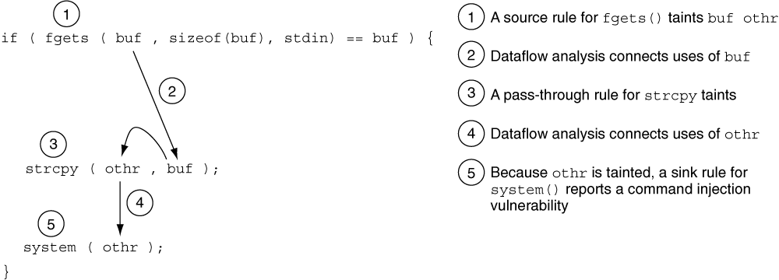
Detect a command injection vulnerability

Slide 55
Rules in Print
Configuration Rules
Model Checking Rules
Structural Rules
Taint Propagation Rules

Slide 56
Taint Propagation Rules
Method or function— Defines the method or function that the rule will match.
Precondition— Defines conditions on the taint propagation algorithm's state that must be met for the rule to trigger.
  preconditions stand for sink rules. If the precondition is not met, the rule will trigger. In the case of sink rules, a violation of the precondition results in the static analysis tool reporting an instance of the vulnerability the rule represents.
Postcondition— Describes changes to the taint propagation algorithm's state that occur when a method or function the rule matches is encountered.
  Postconditions represent source or passthrough information.
Severity— Allows the rule definition to specify the severity of the issues the taint propagation algorithm produces when a sink rule is triggered

Slide 57
A generic static analysis security tool

Slide 58
Reporting Results
Grouping and Sorting Results
Eliminating Unwanted Results
Explaining the Significance of the Results

Slide 59
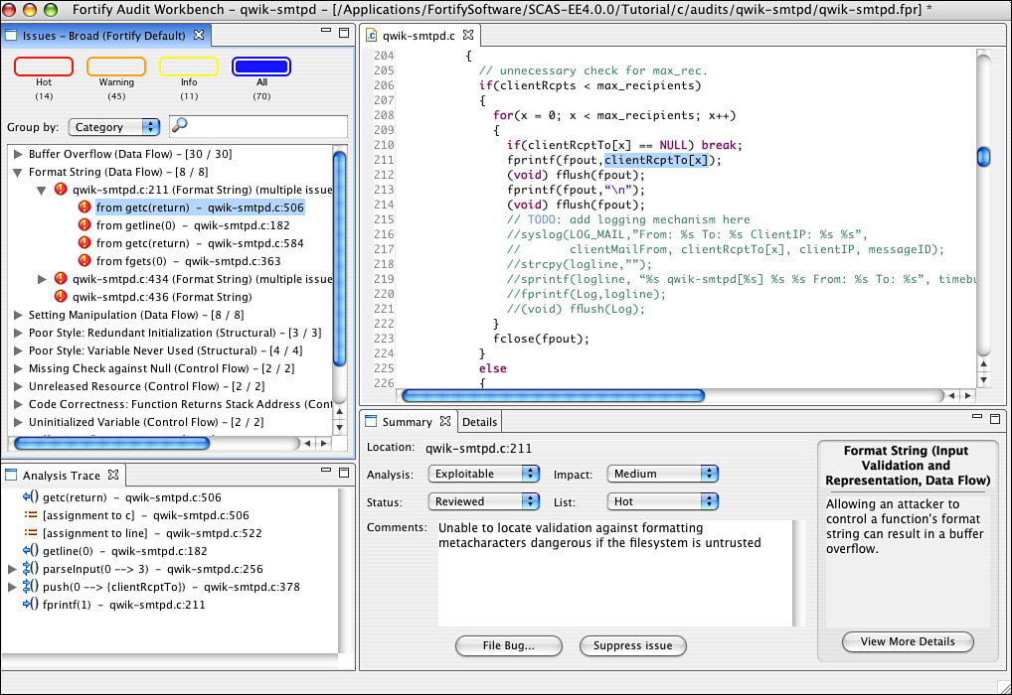
The Audit Workbench Interface

Slide 60
Grouping and Sorting Results
Results in a ranked order
  Most important results appear early in the review
Two dimensions for ranking
  Severity
    Buffer overflow is more sever than a null pointer deference
  Confidence
    Exploitable or just dangerous ?

Slide 61
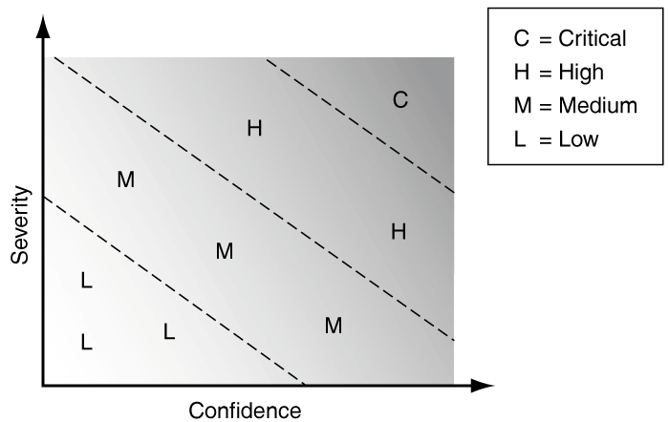
Severity and Confidence Scores

Slide 62
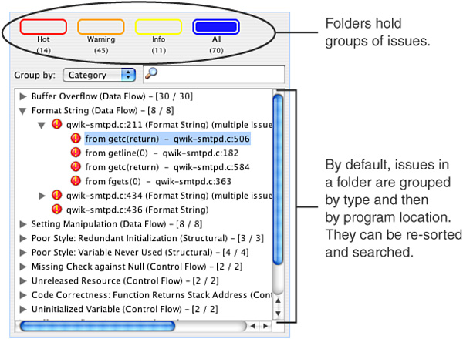
Sorting and searching results

Slide 63
Eliminating Unwanted Results
Share and Merge suppression information in order not to audit the same issues

Slide 64
Explaining the Significance of the Results
Problem Description
Explanation of problem affects
Why it is important
Steps to reproduce the problem
Audit Workbench
  Tainted dataflow
  Textual description of the problem in short and in detailed form

Slide 65
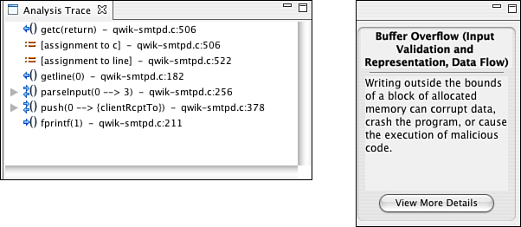
Audit Workbench

Slide 66
Summary
Major Challenges for Static Analysis
  Building a Model
    Trade-offs between Precision and Scalability
  Choosing Algorithms
    Finding the target set of defects
Essential Problems
  Tracking Dataflow and Control flow
  Tracking tainted data
    Trusting Untrustworthy input

Slide 67
Summary
Rule Driven
  How to Model the Environment
  Effects of Library and System Calls
  Security Properties to be Checked
Extensible
  Add rules to model new libraries, environment, or new security properties
Ease of Use
  Results Understanding
  Filter to stand out the results

